Slide 1
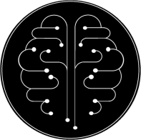
NeuroAudit Proposal
Intelligent Patch Driving Instant Cognitive Boost
© NeuroAudit 2022

Slide 2
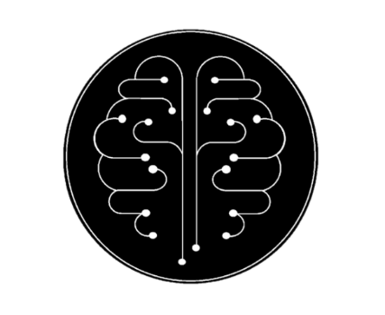
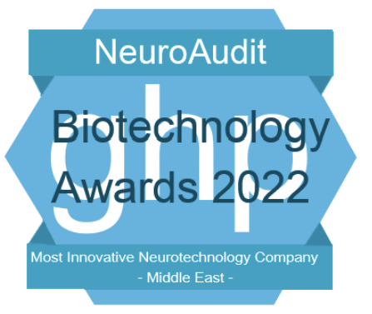
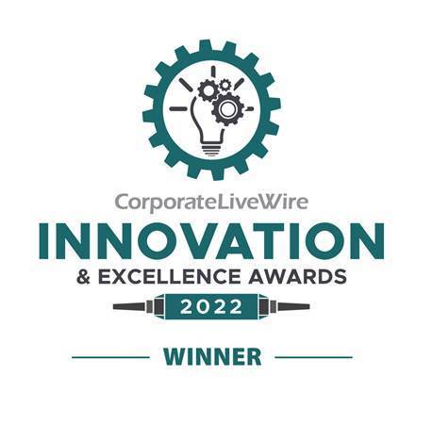
Who Are We?
01.
Multidisciplinary project Founded in 2019
Introduction
02.
Developed an innovative Psychoacoustic Neurotech
03.
Intelligent patch driving an instant cognitive boost in Alzheimer's disease
Most innovative Neurotechnology company of 2022
Neurotechnology innovation specialists of 2022
© NeuroAudit 2022
Notes:
This is the further of making thinks

Slide 3
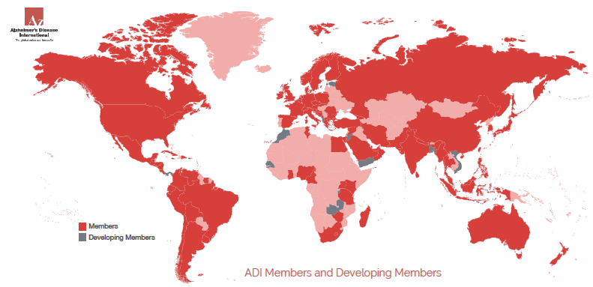
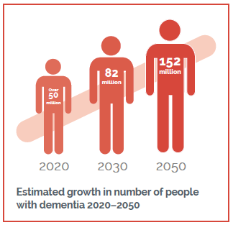
World’s Alzheimer's population
Market Challenge
The world’s older population is more likely to develop Alzheimer׳s disease and dementia, which are associated with cognitive disorders.
The Number of people with dementia is predicted to grow up to 152,000,000 by 2050
© NeuroAudit 2022
Notes:
This is the further of making thinks

Slide 4
1 of 3
people how's suffering from Alzheimer will die with Alzheimer's
Mortality
1 of 3 people suffering from Alzheimer’s will die from Alzheimer’s or dementia.
Its mortality rates are more than those of breast cancer and prostate cancer combined
Alzheimer׳s Market Costs
1.
The number of people with Alzheimer’s will double in 20 years
355$ Billon
Caregivers
2021 costs of healthcare for Alzheimer's
An estimate of 6.2 Million
Americans aged 65 and older live with Alzheimer’s or dementia in 2021.
72% percent are age 75 or older
Alzheimer’s Diseases effects
2.
Alzheimer’s population in the US will double to 13 million by 2040
256.7$ Billon
The cost of care provided by family and caregivers
Prevalence
66% of caregivers live with a person with dementia in the community
Quick Facts
IN 2021, ALZHEIMER'S WILL COST THE NATION $355 BILLION. BY 2050, THESE COSTS COULD RISE AS HIGH AS $1.1 TRILLION.
IN 2020, THESE CAREGIVERS PROVIDED AN ESTIMATED 15.3 BILLION HOURS OF CARE VALUED AT NEARLY $257 BILLION.
MORE THAN 11 MILLION AMERICANS PROVIDE UNPAID CARE FOR PEOPLE WITH ALZHEIMER'S
*** https://www.alz.org/alzheimers-dementia/facts-figures
© NeuroAudit 2022
Notes:
This is the further of making thinks

Slide 5
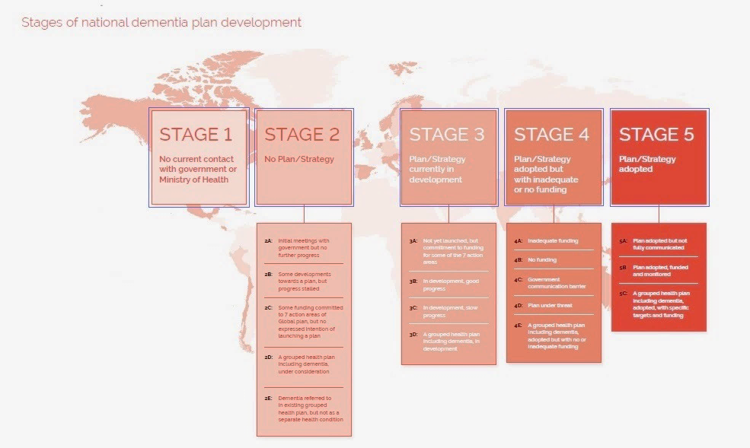
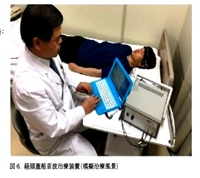
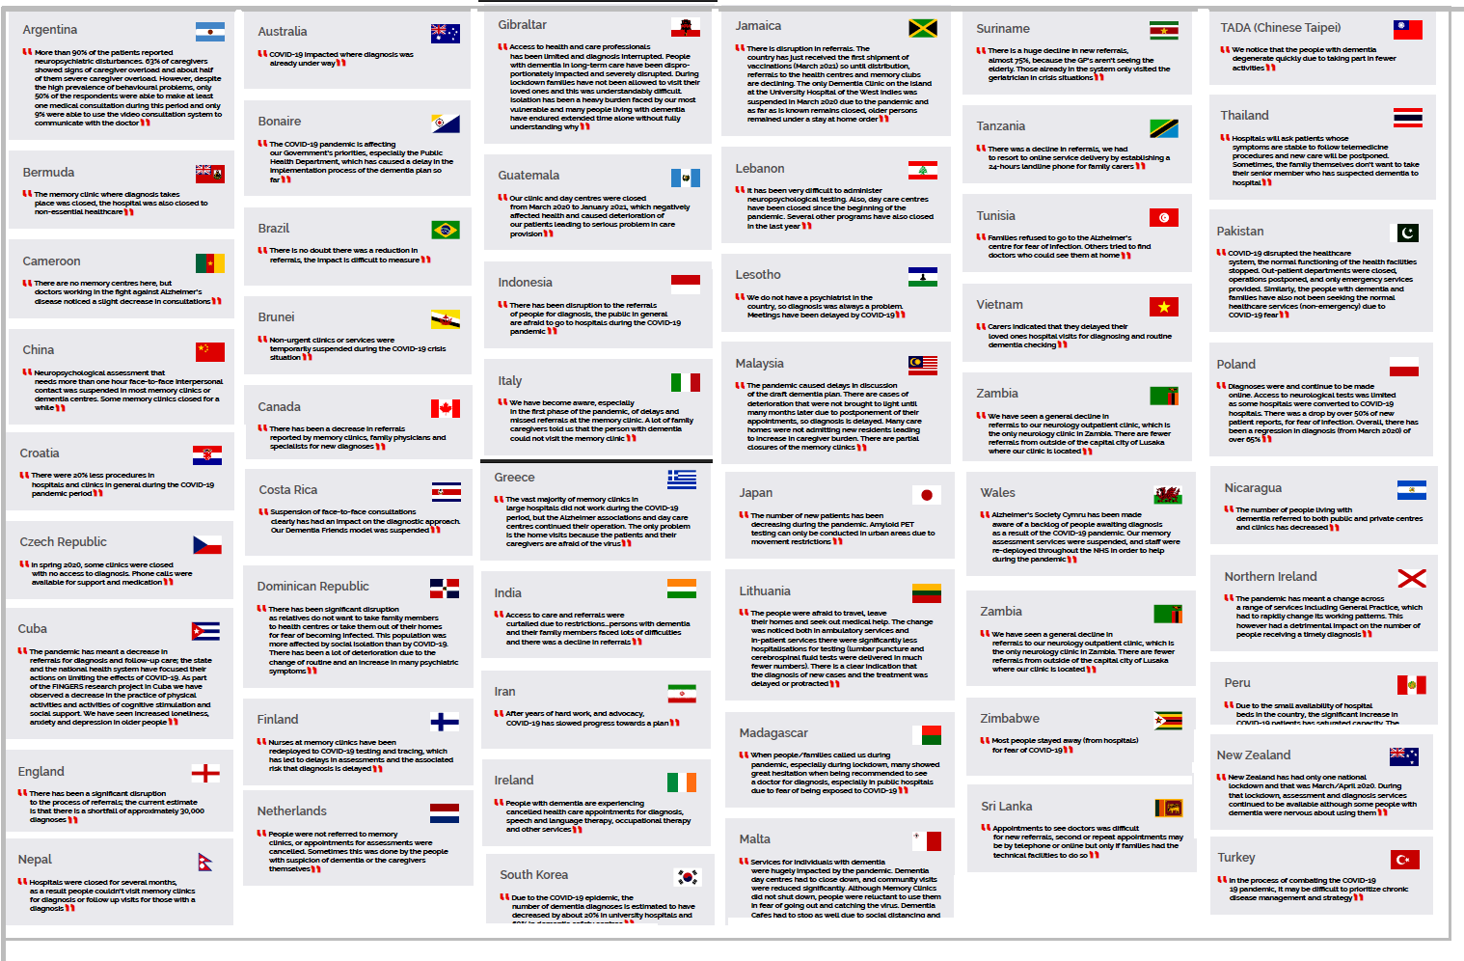
Alzheimer’s Gov Programs
Finding Treatment Proposition
Over the Globe, more than 377 National programs are working with Academic institutions and governments to find treatment for Alzheimer’s disease
© NeuroAudit 2022

Slide 6
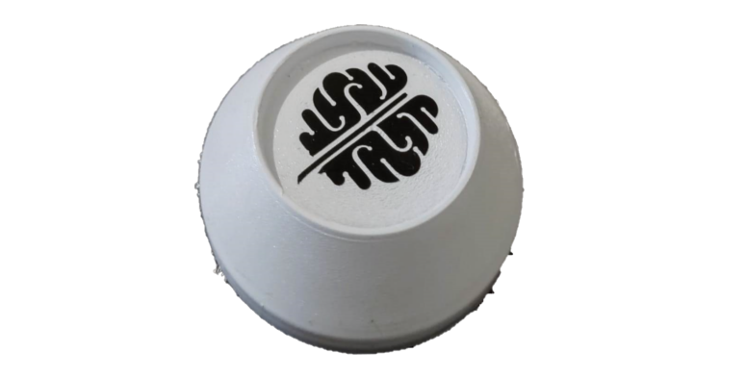
Product Value Proposition
NeuroAudit Product
IMAGINE
“Imagine the Alzheimer's population using a daily patch to get stimulus-enhancing cognitive processes using innovative clinical technology”
Clinical technology, innovative brain stimulation via Blood conduction
The smallest Ultrasound device available
Based on LFUS (Low-Frequency Ultrasound Stimulus)
Creating instant cognitive boost
© NeuroAudit 2022

Slide 7
SAVING LIVES
Knowing that improving cognition with Neuro Audit technology can affect people's lives creates meaning in saving a life.
Value Proposition
SAVING MONEY
What Does it Mean?
NeuroAudit minimizes treatment costs by developing a simple home-based daily treatment with a patch based on brain stimulus technology
MAKING MONEY
Brain technologies that offer a simple home-based daily use by Alzheimer's population business Model.
© NeuroAudit 2022

Slide 8
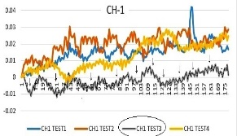
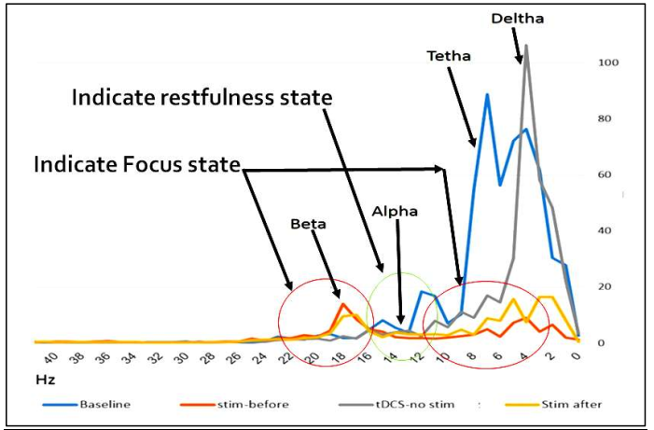
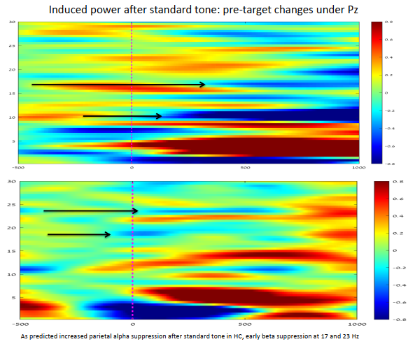
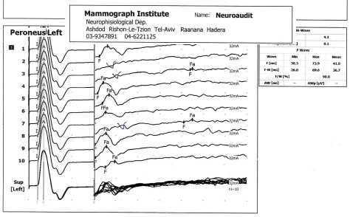
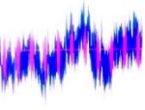
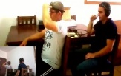
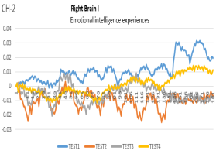
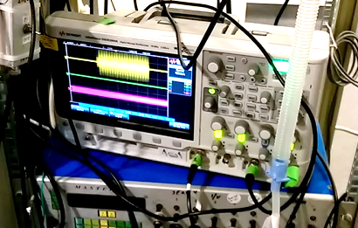
Case Studies
Results:
More than 70% of cognitive performance was CORRELATED with less left-brain activity effort
2020
Japan POC
cognitive performance
POC's Timeline
2016
tDCS Preliminary POC
Detecting Signal effect
2017
ADHD Preliminary POC
Detecting Cognitive Gaps
2019
E.M.G Preliminary POC
Detecting Ultrasonic Effect
2019
ADHD-2 Preliminary POC
Detecting Cognitive
Results:
More than 70% cognitive performance was CORRELATED with less left-brain activity effort
2016
Ronen deaf test
Detecting Ultrasonic signal
2018
Sonic Preliminary POC
Detecting Cognitive Gaps
2019
US Stimulate POC
Brain Ultrasonic Response
© NeuroAudit 2022

Slide 9
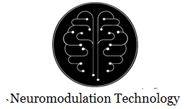
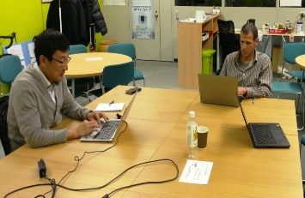
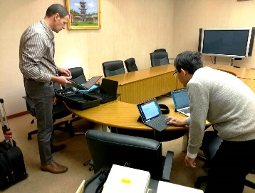
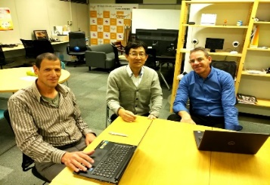
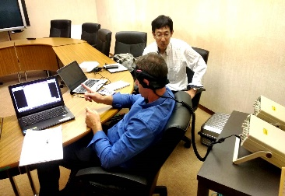
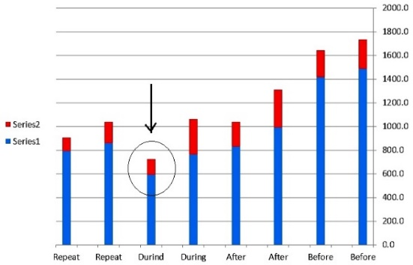
Japan POC (13 Dec. 2019)
Publications based on Ultrasound Neurostimulation
Test case POC with Astem company from Japan (KGAP+ Batch1)
Technology knowledge exchange & results based on Innovative two Brain
Technology integration (Ultrasound Brain Technology & NIR Brain Technology).
NeuroAudit Brain Technology (Ultrasonic brain stimulation)
Stroop effect interference (Cognitive diagnostic)
Ultrasound & NIR Working without artifacts interference
NeuroAudit stimulation influences performance on Cognitive task
Astem NIR System can measure influence with NeuroAudit stimulation.
Cognitive performance enhancement was shown along the stimulating correlated less brain effort in the left Brain (ADHD)
Right Brain
Emotional
Intelligence
Experiences
Left Brain
- language
- logic
- analytical
© NeuroAudit 2020
Notes:
This is the further of making thinks

Slide 10
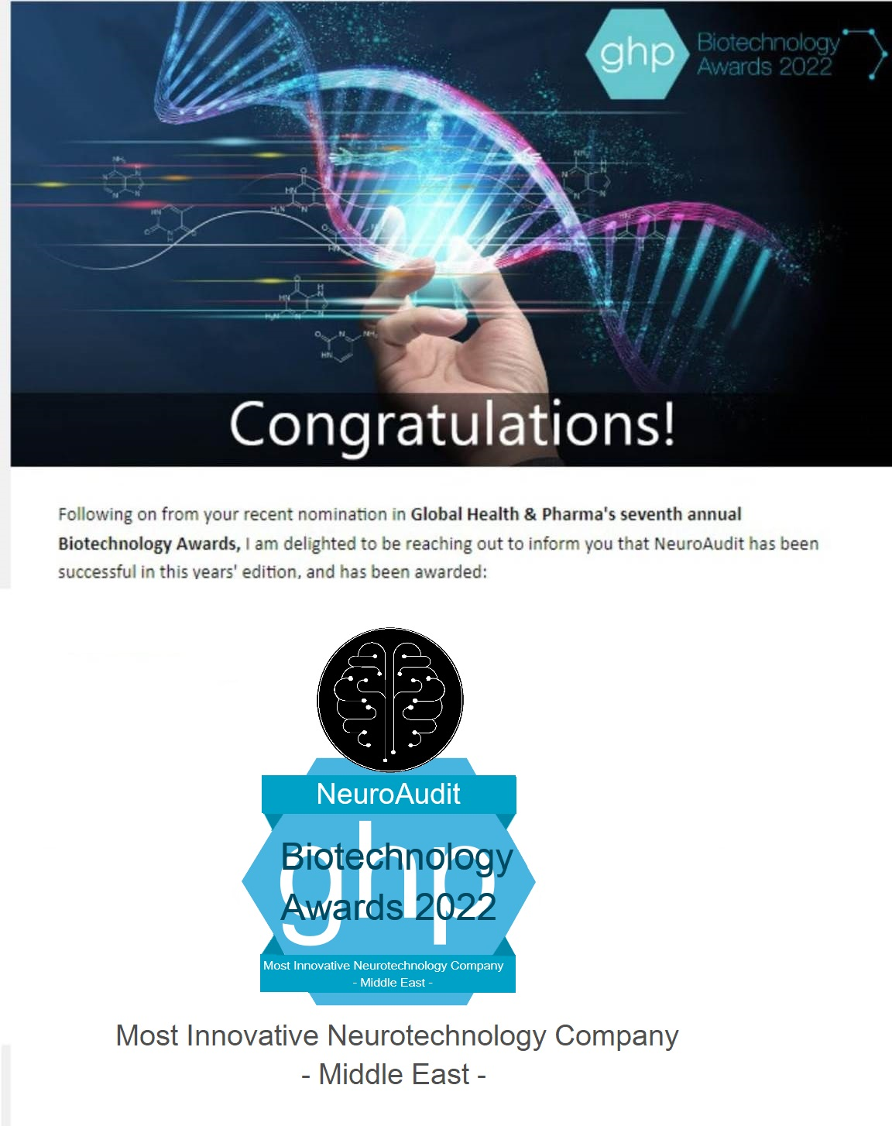
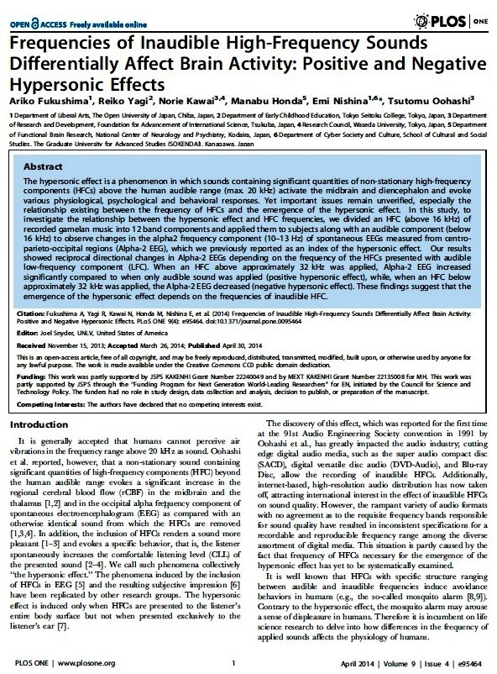
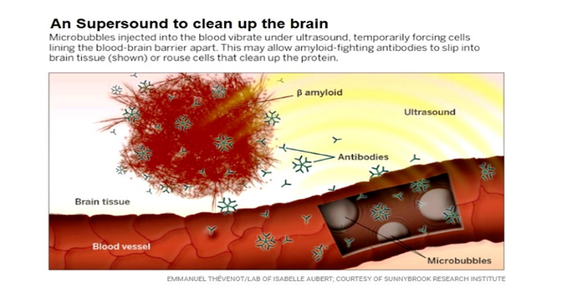
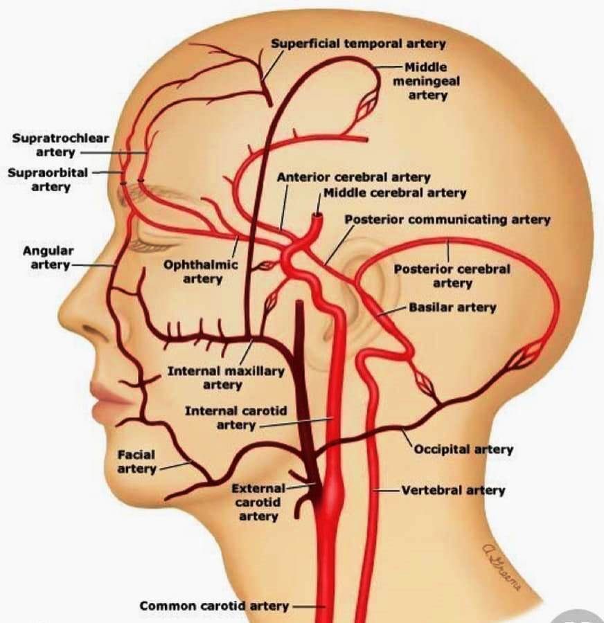
Supporting Clinical and Publications
Publications based on Ultrasound Neurostimulation
© NeuroAudit 2020
Notes:
This is the further of making thinks

Slide 11
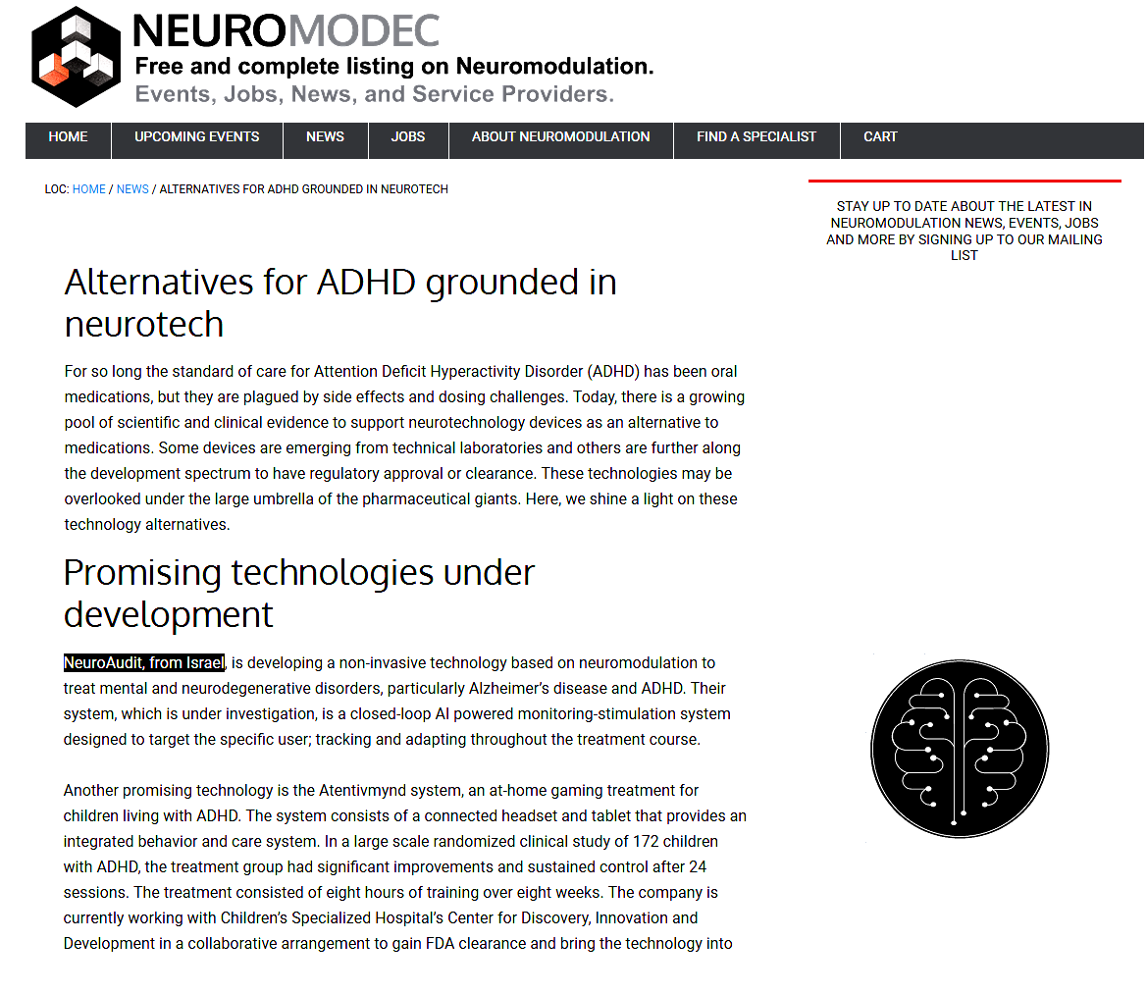
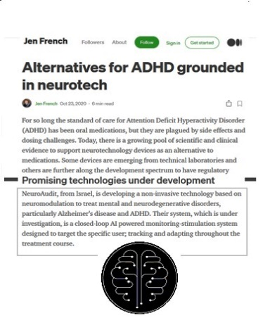
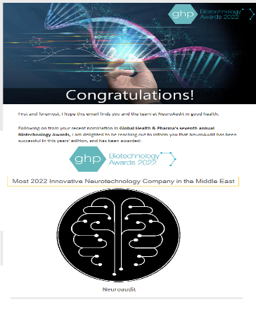
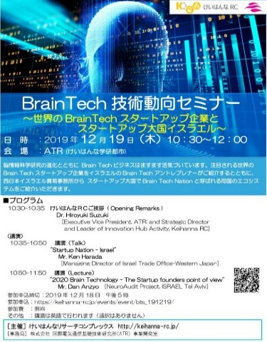
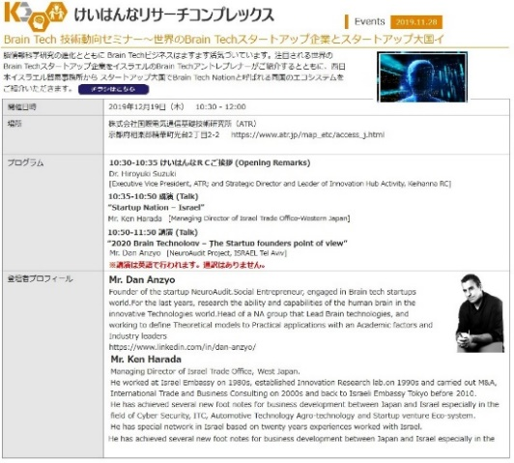
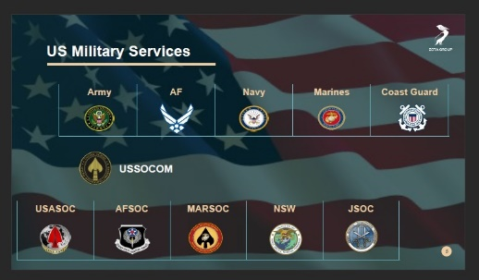
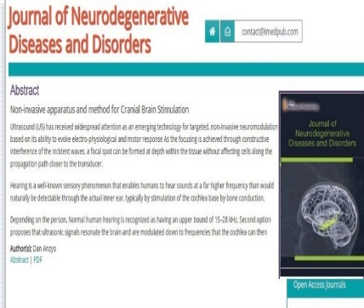
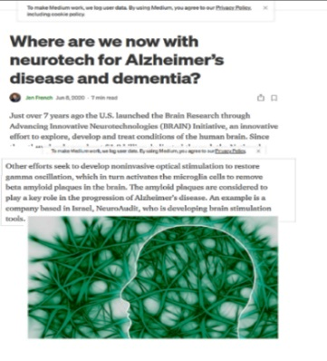
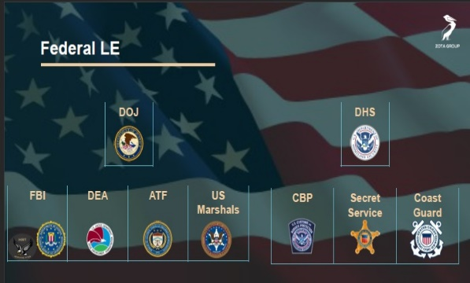
Global Activities
Global
Japan activities
US activities
© NeuroAudit 2022

Slide 12
Key Market
Key Solution
A new case of dementia is reported every 3 seconds
There is an estimated growth in the number of people with dementia from 2020–2050 to 150,000,000
The cost of dementia in 2020 is over US$1 trillion
Simple to use. Operates independently
Technology innovation is based on "blood conduction“
Using a unique modulation to improve cognitive function
For daily use
1.
Market
2.
Solution
Key Factors
Investment Thesis
3.
Forecast
4.
Model
Key Model
Key Forecast
B2B Model
Initial customers - Pharma companies & potential dealers
2nd customers - mid/local area pharma networks
To provide our over 1,000,000 units targets.
The product is ready for the market
6 months from the GTM ,10,000 units will be produced as part of introduction sales
After an additional pried of 18 months, expected introduction quantities are 200,000 to 350,000
© NeuroAudit 2022

Slide 13
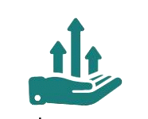
Product Roadmap
Timeline to GTM
Invest in Intelligent Neurotech
Business model
Recurrent Revenue: pay per weekly unit (8 units)
Initial customers - Pharma companies & potential dealers
2nd B2B customers – mid/local area pharma networks
2021
Seed funding
2022
FDA approval
2022
Clinical trails
2023
Go to market
2020
MVP ready
Investment traction
Huge market - Alzheimer’s in the US will double to 13 million
Product is ready for the Market
Innovative, simple to use, No services
Disrupting Technology
Investment Roadmap
First millstone - 9 months
Second millstone - 14 months
Grow millstone - 18 months
Milestone timeline 18 \ 14 \ 9 months
© NeuroAudit 2022

Slide 14
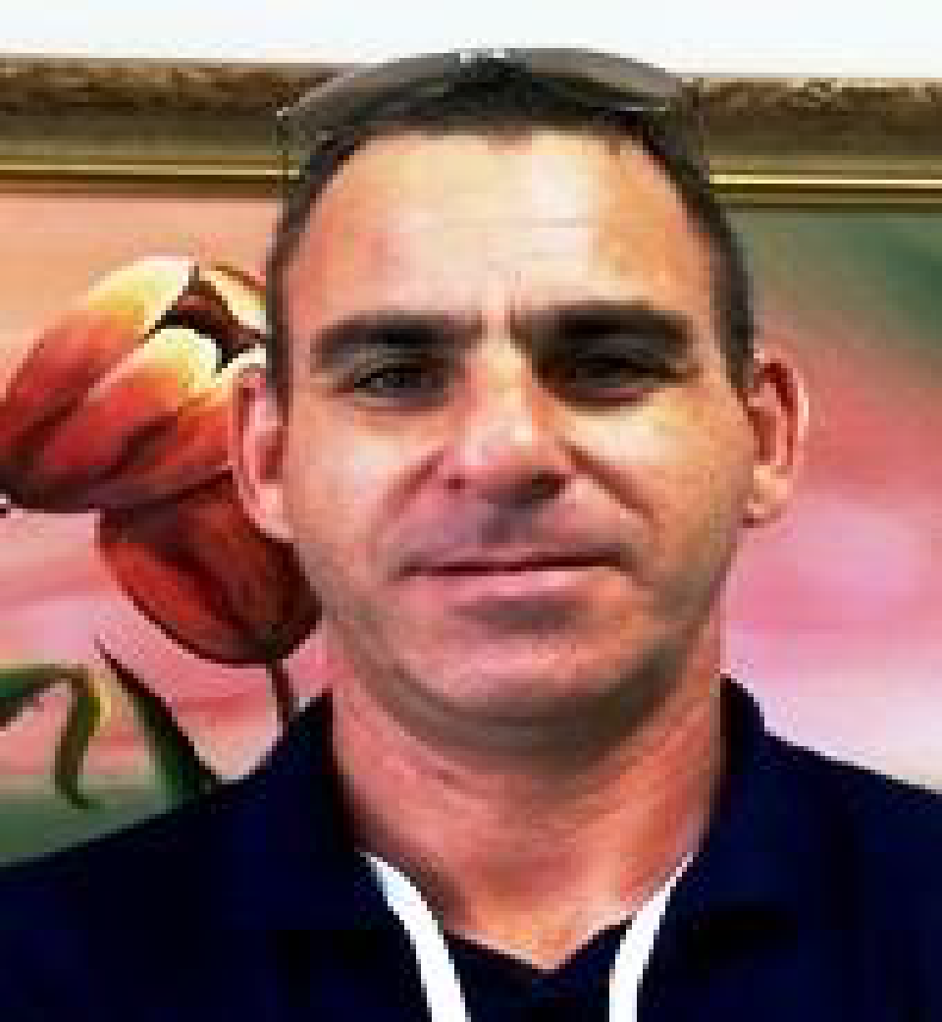
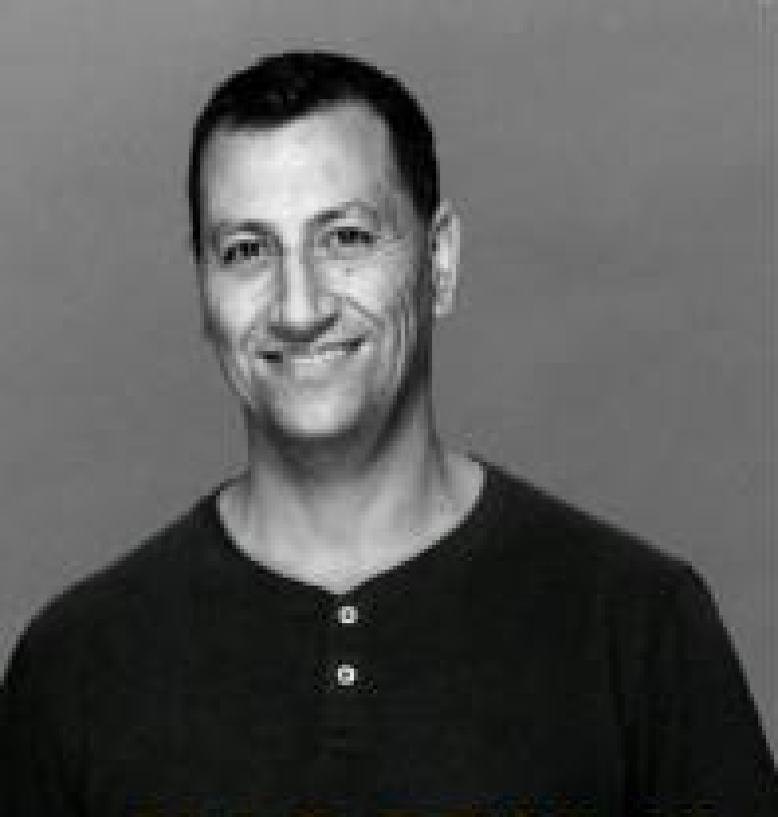
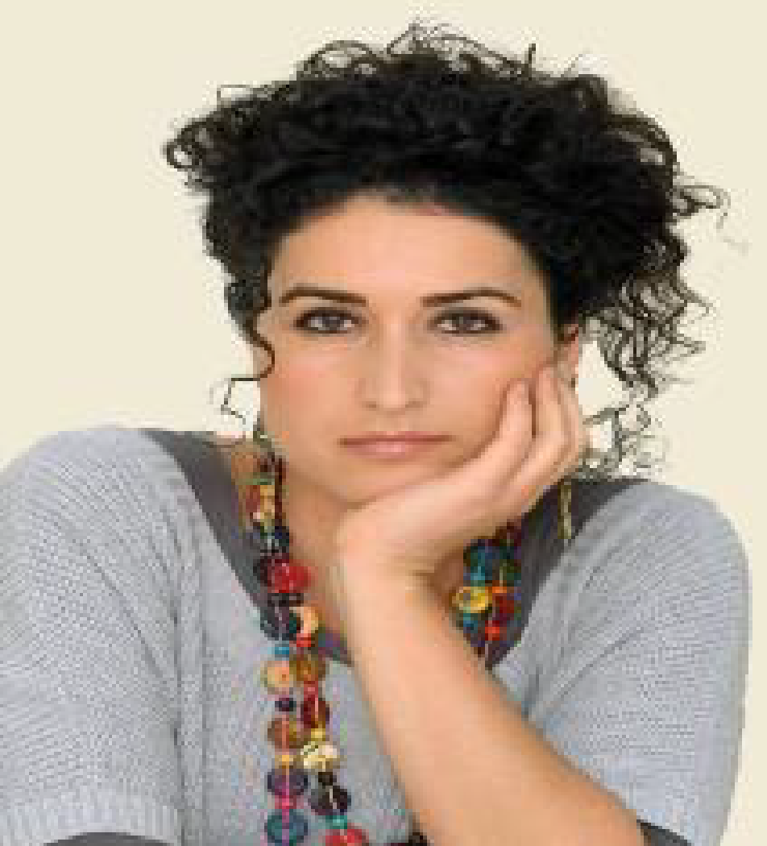
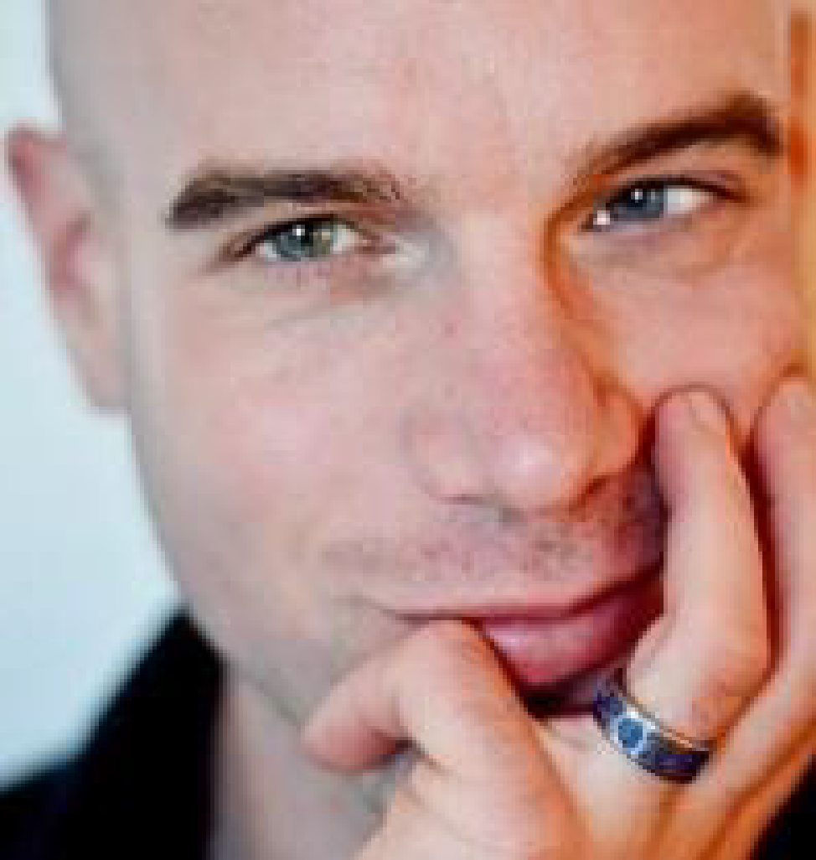
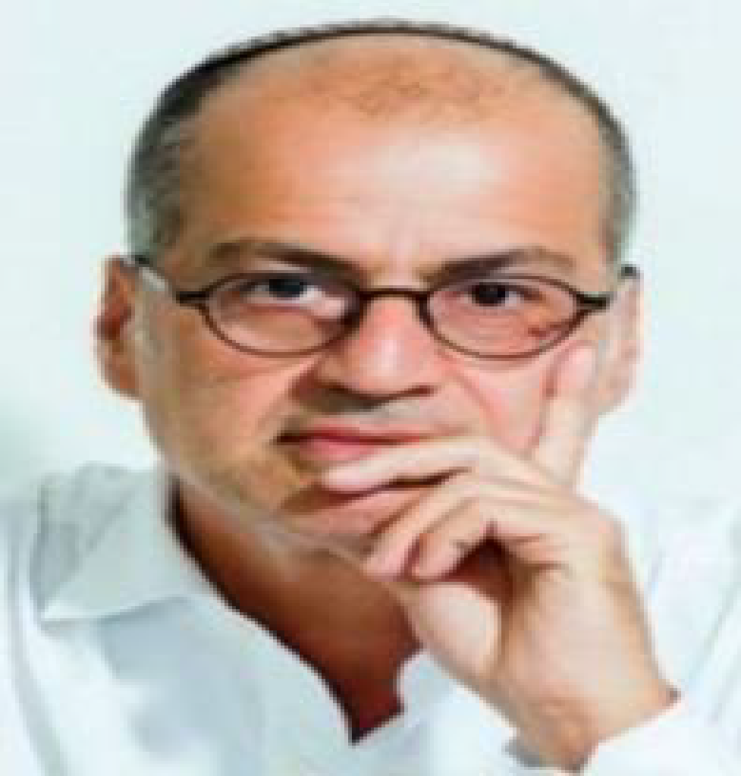
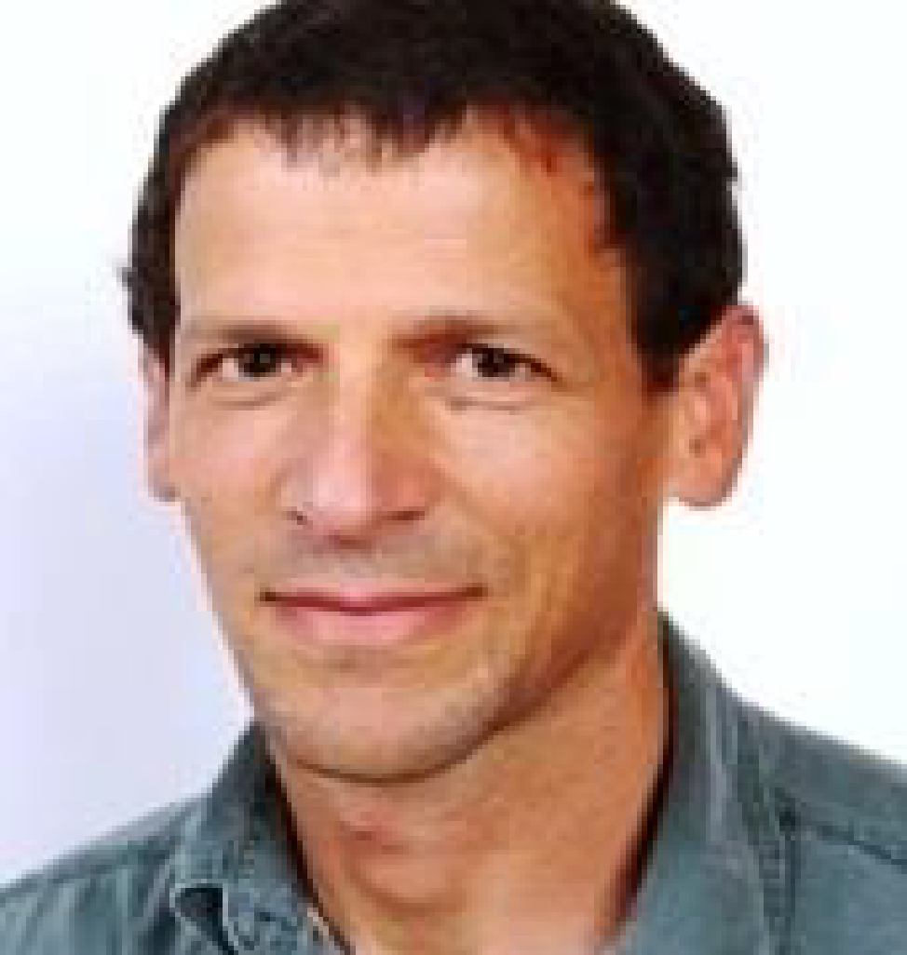
Dan Anzio
CEO & Business Development
Erez Saadon
CTO & R&D Designer
Rachel Langford,
MSc.Med, Clinical Science
.
Esther Fuerster-Askhenazi,
Clinical programs
.
Leads the management and strategy of NeuroAudit, experienced in marketing & technology development with a blend of business acumen and implementing marketing plans to maximize results and bring to the table a strategic view, high analytical skills, leading to result in business growth and personal empowerment
Heads the R&D Technology Research at NeuroAudit. Responsible for researching the bi-lateral development Technology interaction
Is areas for many years as an electronical, software engineer
Heads the Research at NeuroAudit. Neuroscientist and a clinician in private brain assessment and training clinics using HEG NIRS and EEG technology for improving brain functions. Her previous research fields were in medical neuroscience and health psychology.
Many years in the field of forensic genealogy; assisted a governmental agency to build their research system in Poland, and Eastern Europe; increasing their response rate.
Has close ties with governmental and non-governmental organizations in Israel and around the world.
Leadership
Team
Dr. Boaz Sadeh
Clinical Science Advisory board
Dr. Lionel Krief
MD Advisory board
Dr. Alon Sinai
Clinical Science Advisory board
R&D clinical science, computational neuroscientist, and electrophysiologist. Served as lead neuroscience and researcher in the medical device industry and has more than 15 years of research experience working with EEG, functional MRI, and transcranial magnetic stimulation (TMS)
Medical expert with a specialty in nuclear medicine. Has diagnosed Alzheimer’s Disease in the EU for over 20 years, specializing in nuclear medicine and PET (two imaging modalities used to examine organ function)
Neurophysiologist in the department of neurosurgery at Rambam Medical Center, Haifa. Was a research fellow at Johns Hopkins University, Baltimore, Maryland (2003-2008). Specialized in evoked potentials, electrophysiology, and methods of electrical and magnetic stimulation for the treatment of various disabilities in the nervous system

Slide 15
Invest in the future of Humanity with us
NeuroAudit

